Slide 1

Software Engineering
Iram Aziz
Computer Science Department

Slide 2
Introduction?
Today’s work
Course Outline
Requirement Analysis methods

Slide 3
Purpose of Course?
Practical application of theoretical knowledge gained in computer science

Slide 4
Process
input
product

Slide 5
Software development life cycle(SDLC)
Waterfall
Incremental
Rapid
Iterative
Evolutionary
Agile

Slide 6
Waterfall SDLC
Simplest
Oldest
Most widely used
5 phases
Similar terminology used in different organization
All phases are interlinked
Output of one phase is input of next phase

Slide 7
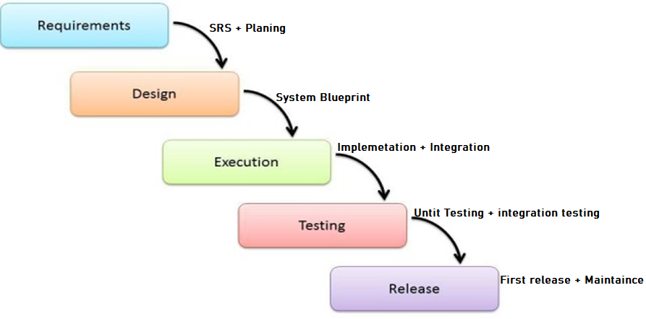
Waterfall SDLC

Slide 8
1. Requirement
Requirement Gathering
Methods
Interviews
Requirement Engineering
Questionier
Brain storming
Focus group

Slide 9
Requirement Engineering
The process of
Defining
documenting
and maintaining requirement

Slide 10
Elicitation
Related to use the various ways to gain knowledge about project domain and requirement
Ways
Interviews(Brainstorming)
Business manuals (Task analysis)
Brain storming
Existing software of same type(Prototype)
Does not produce any formal model
Its broaden the domain of knowledge

Slide 11
Requirement Engineering
Requirement Specification
This activity used to produce formal statement model
Functional
Non- functional
Constraints(time constraints, development constraints, standards)
More knowledge gain triggers elicitation

Slide 12
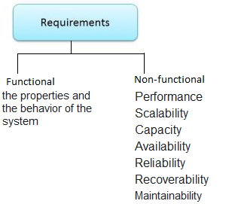

Slide 13
Error propagation

Slide 14
1. Requirement Analysis
Feasibility study
Other metric and standers

Slide 15
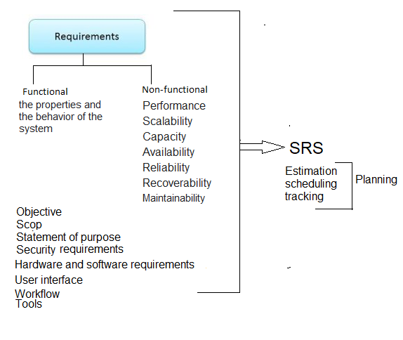
1. Requirement

Slide 16
1. Requirement

Slide 17
Agile
Extreme Programming
Scrum

Slide 18
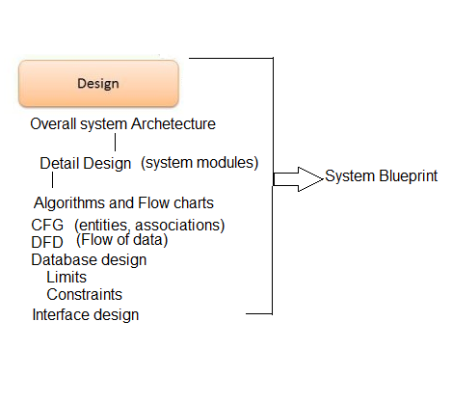
2. Design

Slide 19
3. Design
UMLS
USE CASE
CFG
ERD
DFDS
FLOW CHARTS
CLASS DIAGRAMS
SEQUENCE DIAGRAM
Database design

Slide 20
4. Implementation
Modular
Integration

Slide 21
5. Testing
Modular
System

